Slide 1
Epidemiology of Vitamin D Deficiency and COVID-19
William B. Grant, PhD
Sunlight, Nutrition and Health Research Center
San Francisco
www.sunarc.org
wbgrant@infionline.net

Slide 2
Introduction
The COVID-19 pandemic has ravished the world for over a year and a half, resulting in more than 181 million cases and 3.9 million deaths as of June 25, 2021 according to https://www.worldometers.info/coronavirus/
The economic damage due to lockdowns, etc., is much greater than estimated based solely on cases and deaths.
Much of the losses due to COVID-19 could have been prevented through vitamin D supplementation.

Slide 3
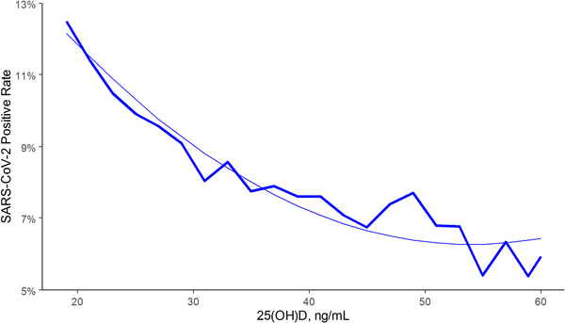
SARS-CoV-2 positivity rates and circulating 25(OH)D levels in the total population, U.S.
Based on tests for more
than 190,000 patients from mid-March through mid-June 2020
who had serum 25(OH)D tests within the past year by Quest Diagnostics. The 25(OH)D values were
seasonally adjusted.
50
nmol/L
140
nmol/L
Kaufman,… Holick, PLoS One. 2020;15(9):e0239252.

Slide 4
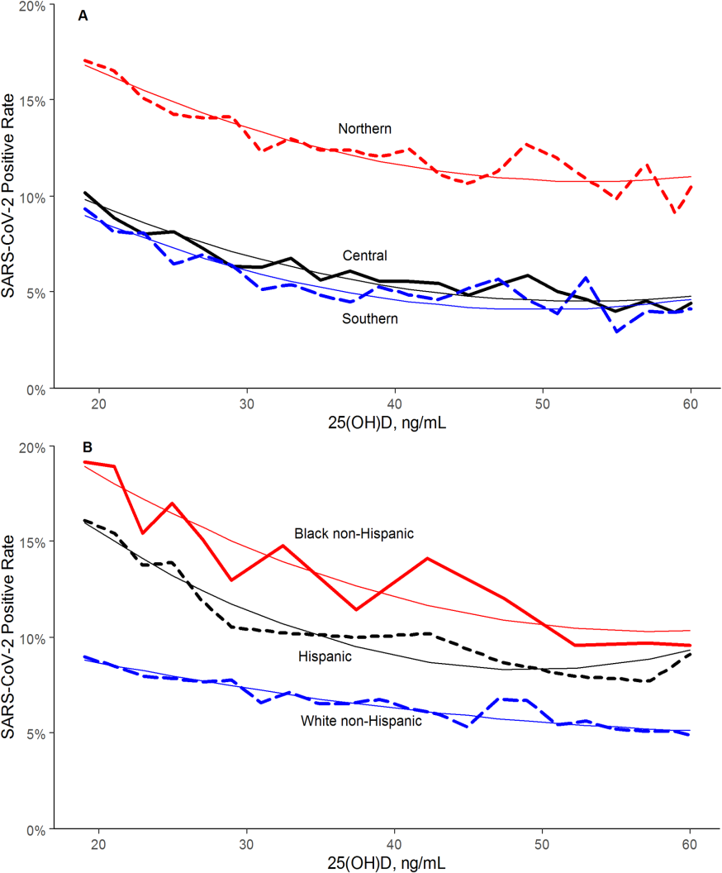
Effects of Race and Latitude on SARS-CoV-2 Positivity vs. 25(OH)D
The findings for latitude were affected by different variants of SARS-CoV-2; the European variant in New York and surrounding states was much more infective than the Chinese variant in most of the country.
The findings regarding race/ethnicity
and seropositivity indicate that blacks
and Hispanics have higher rates than
whites primarily due to non-vitamin D
effects. However, if blacks and Hispanics
were to increase 25(OH)D concentrations
by vitamin D supplementation, they
could reduce seropositivity by about 30%.

Slide 5
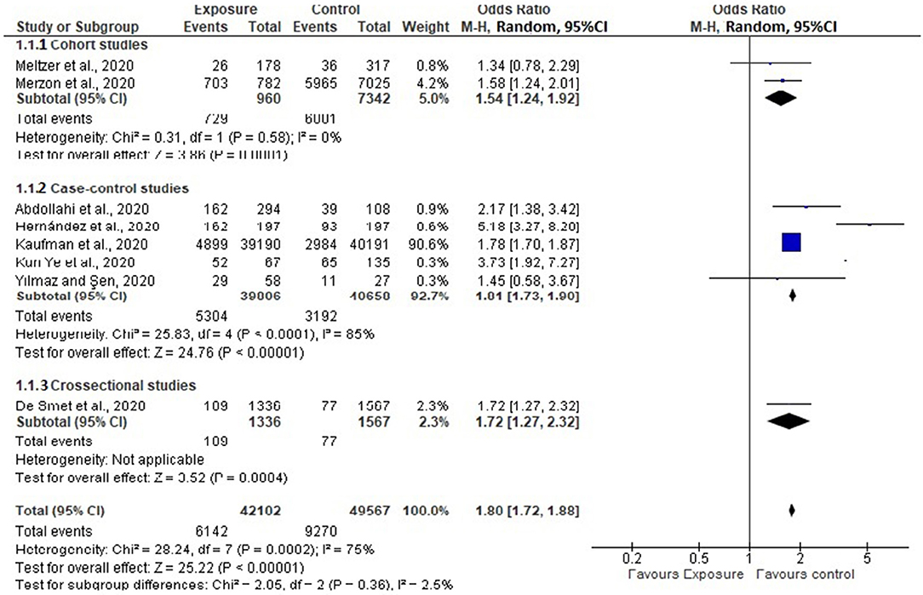
Effect of Vitamin D Status and COVID-19 Incidence from Observational Studies
Increased risk for vitamin D deficiency
54%
81%
72%
Teshome A, et al. Front Public Health. 2021 Mar 5;9:624559.

Slide 6
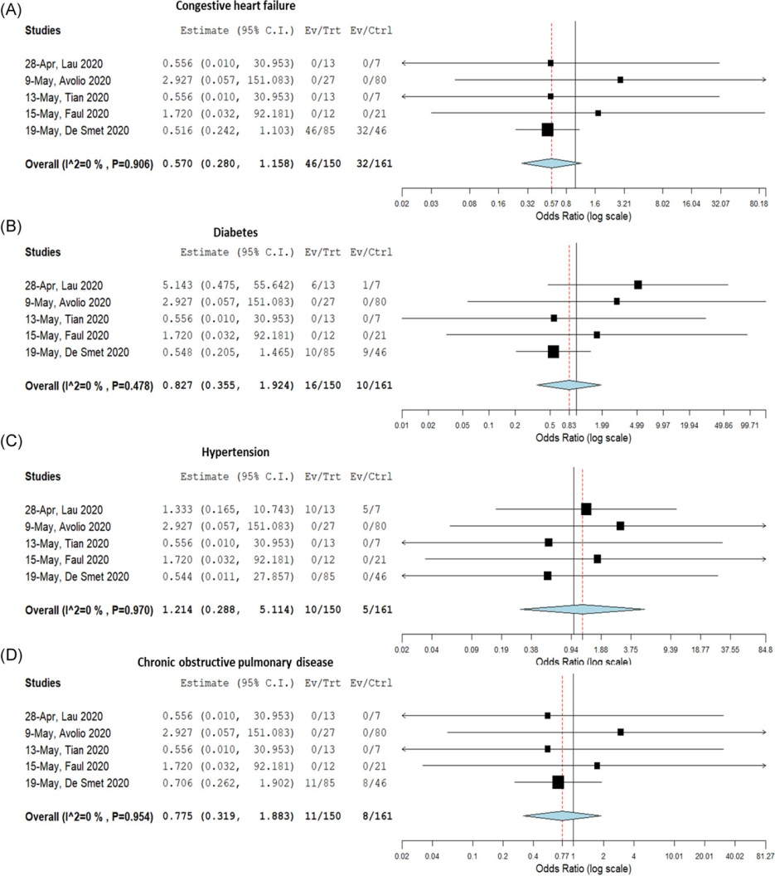
Forest Plot Showing Pooled Summary for the Proportion of Comorbidities and Risk of COVID-19
Congestive heart failure.
Diabetes mellitus.
Hypertension.
Chronic obstructive pulmonary disease
Munshi R, et al. J Med Virol. 2021 Feb;93(2):733-740.

Slide 7
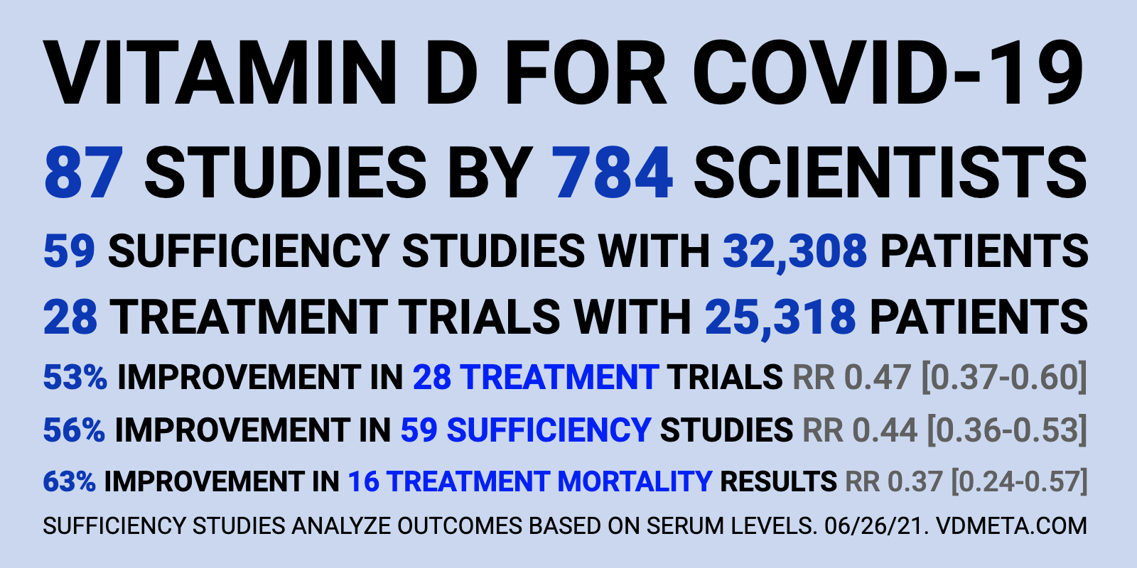
https://c19vitamind.com/

Slide 8
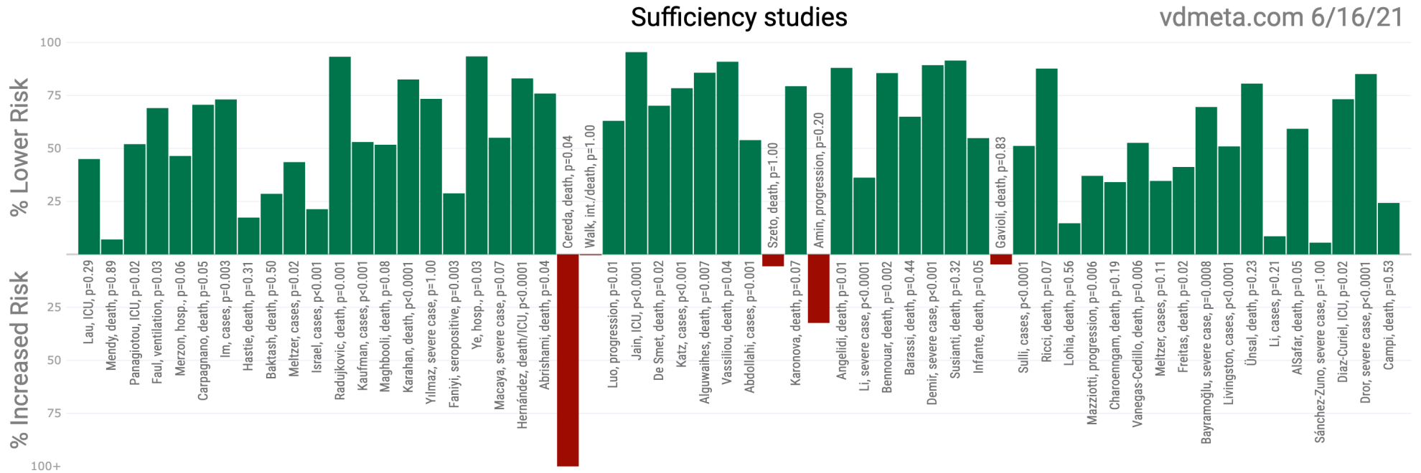
B. Scatter plot showing the distribution of effects reported in serum level analysis (sufficiency) studies

Slide 9
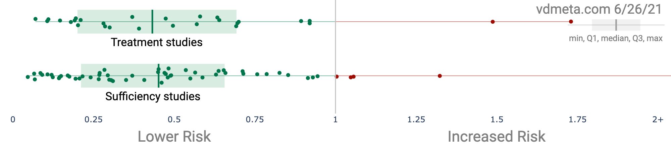
B. Scatter plot showing the distribution of effects reported in serum level analysis (sufficiency) studies and treatment studies

Slide 10
Conclusion
Observational studies find that vitamin D reduces risk of SARS-CoV-2 infection and progression to COVID-19 and that vitamin D or calcifediol [25(OH)D] supplementation reduces severity of and death from COVID-19.
We are still waiting for randomized controlled trials demonstrating that vitamin D is useful for preventing and treating COVID-19. The medical system considers such trials the gold standard of proof.

Slide 11
Roadblocks to Acceptance of Vitamin D re COVID-19
In order to obtain emergency use authorization for COVID-19 vaccines, the WHO and the USA Food and Drug Administration had to assert that no simple means were available to prevent or treat COVID-19.
In addition, Big Pharma has suppressed information regarding vitamin D in general in order to increase income and profit and protect COVID-19 vaccines using the Disinformation Playbook:
http://www.orthomolecular.org/resources/omns/v14n22.shtml

